Slide 1
Pengamatan Virtual Langit Malam Observatorium Bosscha
Seri XII: Observasi Planet
Dari Masa ke Masa
Evan I. Akbar
KK Astronomi - fisika bintang
& Observatorium Bosscha
24 Okt 2020

Slide 2
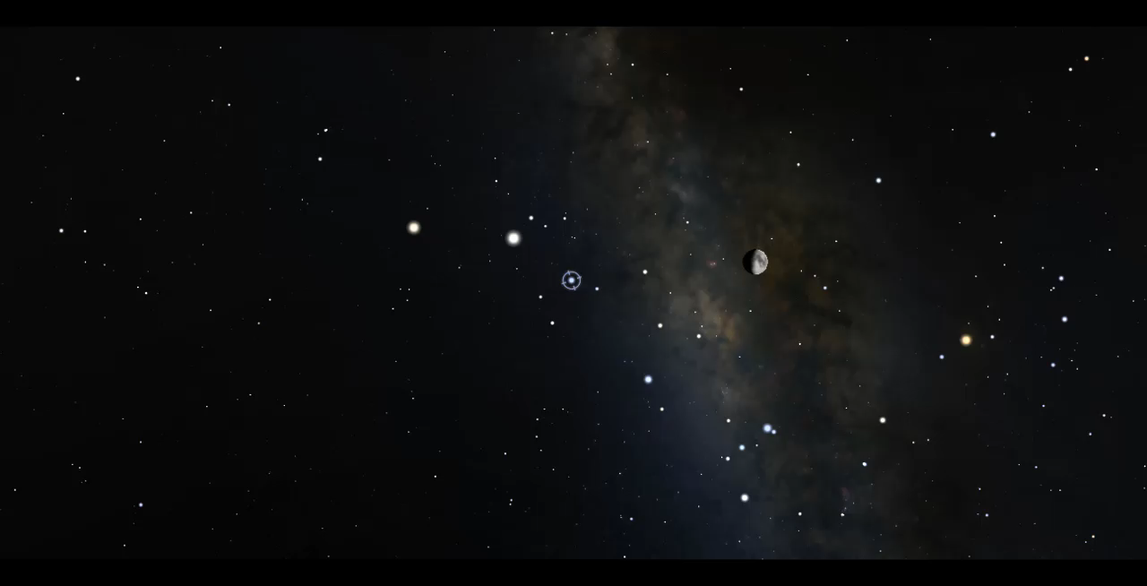
Pengembara yang bergerak diantara bintang-bintang
Stellarium
Notes:
Planet: “bintang” yang bergerak di langit dan tidak berekor

Slide 3
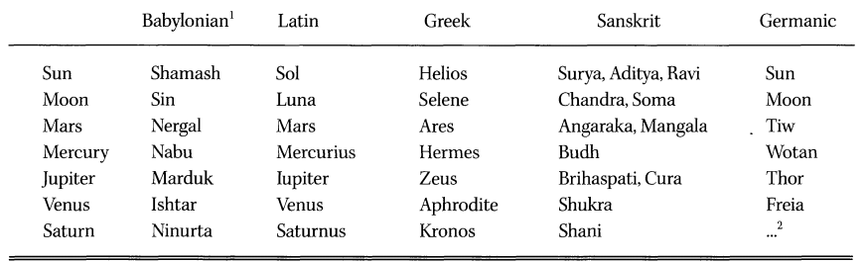
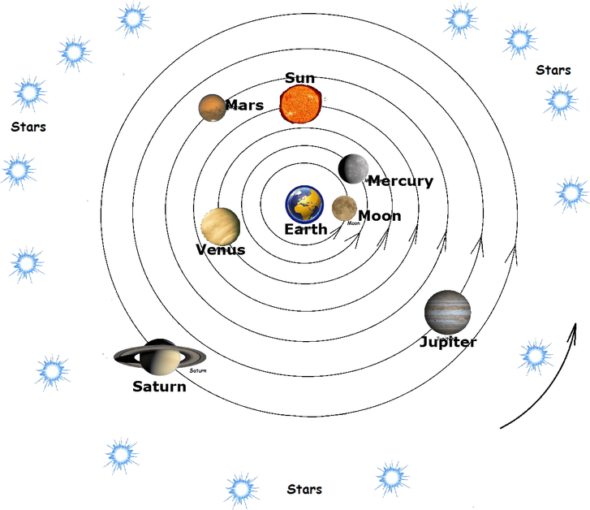
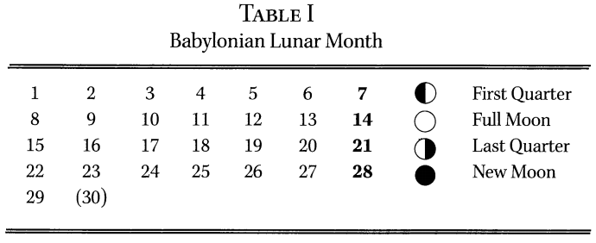
Planet yang dikenal dari jaman dahulu
Falk, 1999, Astronomical Names for the Days of the Week, JRASC

Slide 4

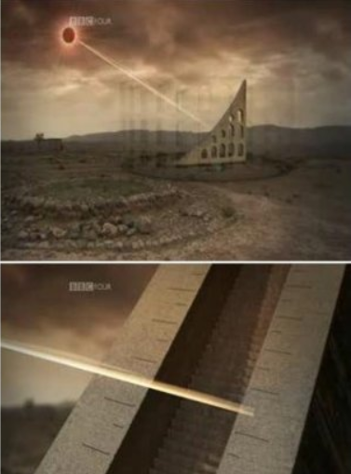
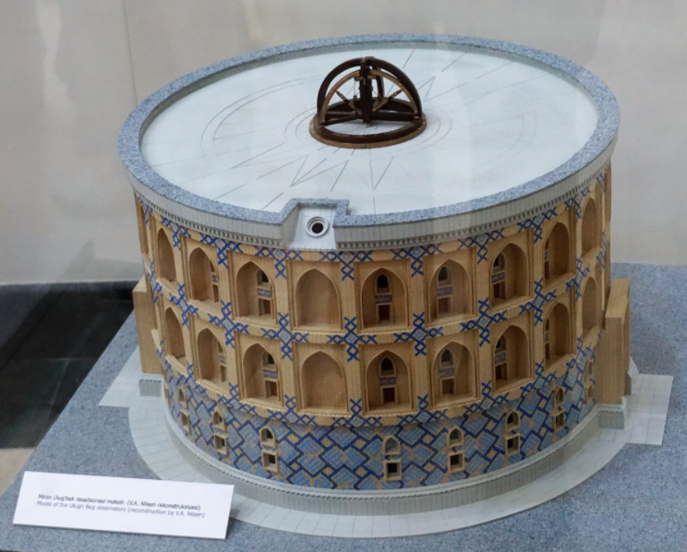
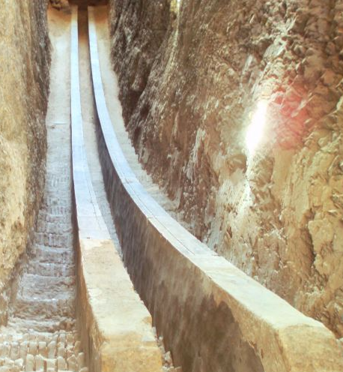
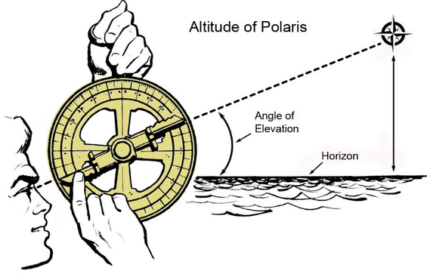
Mengukur posisi planet dan bintang
Peralatan sederhana
Observatorium Maragheh, 1259 (BBC Four)
Observatorium Ulugh Beg, 1420
Notes:
Planet: “bintang” yang bergerak di langit dan tidak berekor

Slide 5
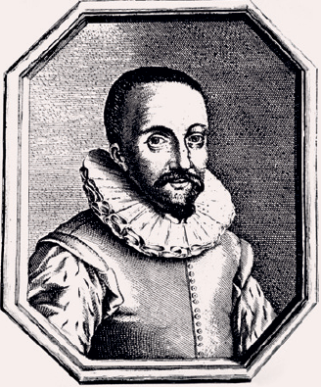
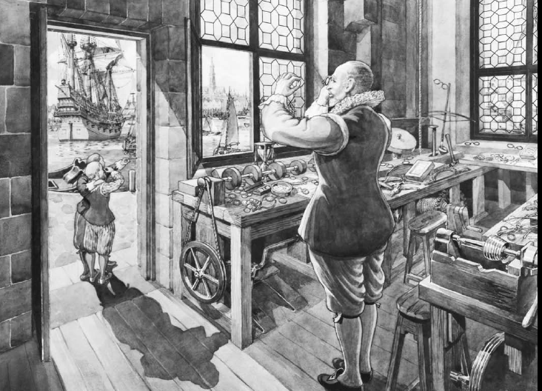

Hans Lipperhey:
Pemegang hak paten ‘looker’ (1608)
Notes:
Pemegang hak paten spyglass 9looker): Hans Lipperhey

Slide 6
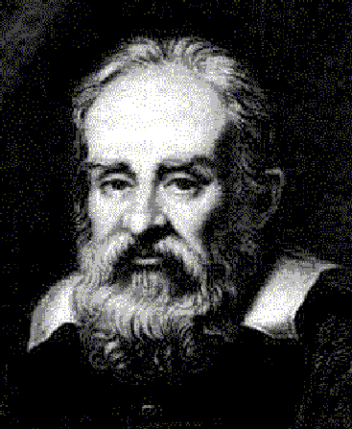
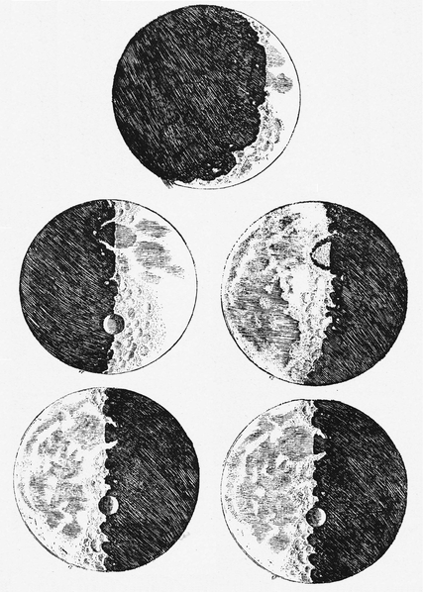
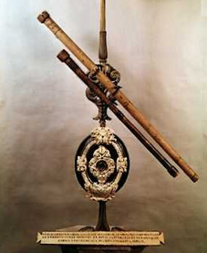
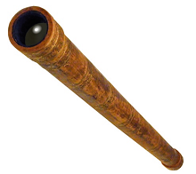
Galileo Galilei: teleskop (1609)
Sketsa Bulan (30 Nov 1609)
Teleskop Galileo (2,6 cm, f=133 cm)
Notes:
One of Galileo's telescopes. The focal length is 1330 mm with a 26 mm aperture, it magnifies 14x. It has an objective bi-convex lens and a plano-concave eyepiece.
Pertama kalinya umat manusia melihat dengan jelas permukaan benda langit. Bulan tampak seperti Bumi, memiliki kawah dan juga “laut”

Slide 7


Slide 8
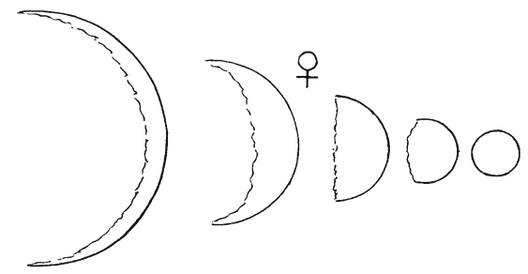
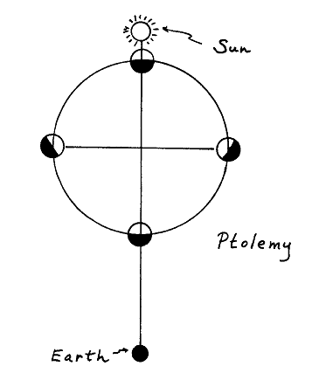
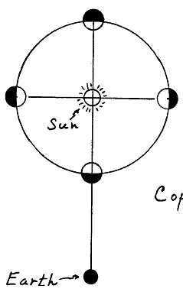
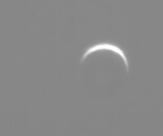
Pengamatan Planet: Venus
Venus mengalami perubahan fase.
2
2
1
1
Sketsa Venus oleh Galileo Il Sagiatore (1623)
Venus, 2020
Geosentris
Heliosentris
Notes:
Galileo’s depiction of the phases of Venus, from Il saggiatore (1623)
Pengamatan Galileo ini mendukung teori heliosentris yang dicetuskan Nicolaus Copernicus tahun 1543

Slide 9
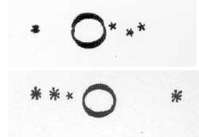
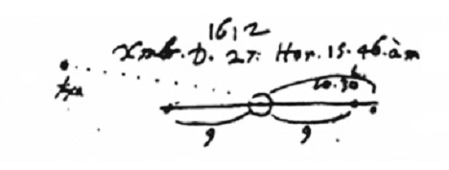
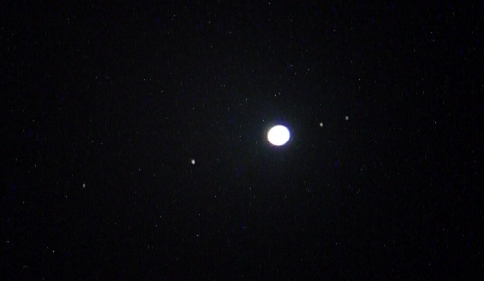
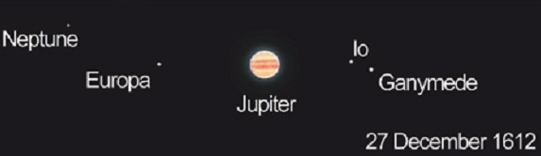
Pengamatan Planet: Jupiter
Sketsa Jupiter (1610)
Tidak semua benda langit berevolusi mengelilingi Bumi seperti yang orang Yunani perkirakan.
Pengamatan modern
Notes:
Galileo unwittingly observed Neptune on three occasions, thinking it was a “fixed star.” This is his first observation, made on December 27, 1612, compared with a computer simulation of the same scene

Slide 10
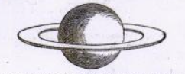
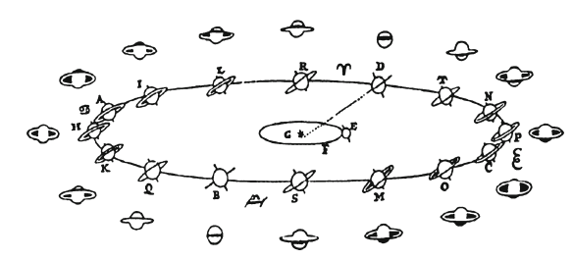

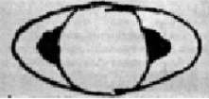
Pengamatan Planet: Saturnus
30 Juli 1610: “… the star of Saturn is not a single star, but is a composite of three … and they are situated in this form: oOo “
Christiaan Huygens menggambarkan cincin Saturnus (1659)
1610
1616
Sketsa Saturnus
Huygens: Systema Saturnium (1659)
Notes:
In July, as Saturn was bright in the evening sky and approaching opposition,[1] he turned his telescope toward it and made a new discovery. On 30 July he wrote to his Medici patron:
I discovered another very strange wonder, which I should like to make known to their Highnesses . . . , keeping it secret, however, until the time when my work is published . . . . the star of Saturn is not a single star, but is a composite of three, which almost touch each other, never change or move relative to each other, and are arranged in a row along the zodiac, the middle one being three times larger than the lateral ones, and they are situated in this form: oOo.

Slide 11
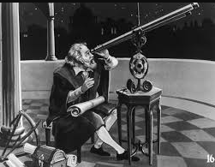
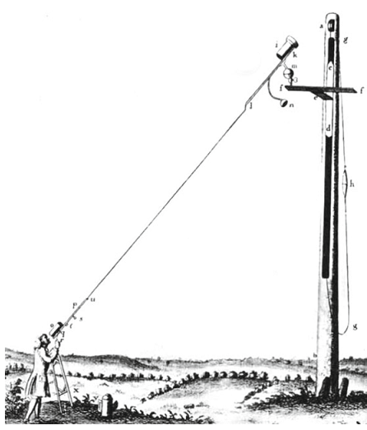
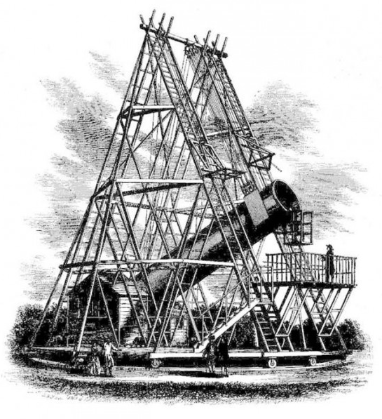
Perkembangan teleskop
Teleskop William Herschel (1789)
Teleskop Galileo (1609)
Teleskop Hyugens (1686)

Slide 12
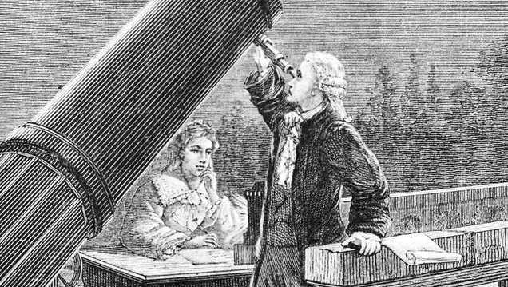
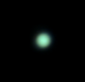
Penemuan planet: Uranus (1781)
William Herschel dan adiknya, Caroline
Uranus
Gambar: Tom Urbain

Slide 13
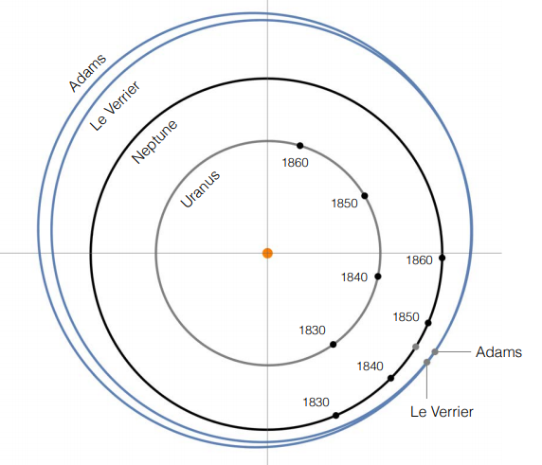
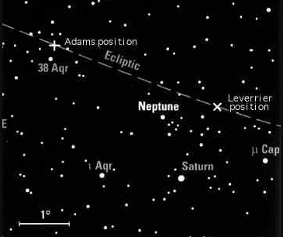
Penemuan planet: Neptunus (23 Sept 1846)
Pernah diamati Galileo, 1612-1613 (Standish & Nobili, 1997)
Penemuan secara matematis oleh Urbain Jean-Joseph Le Verrier dan John C Adams (observasi: Johann G Gale)
Notes:
In 1821, Alexis Bouvard had published astronomical tables of the orbit of Uranus, making predictions of future positions based on Newton's laws of motion and gravitation.^{[15]} Subsequent observations revealed substantial deviations from the tables, leading Bouvard to hypothesize some perturbing body.

Slide 14

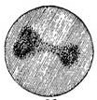
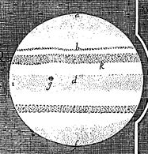
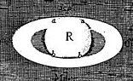
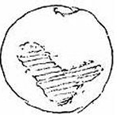
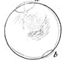
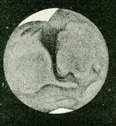
Perkembangan instrumen astronomi
Fontana 1638
Galileo 1610
Galileo 1616
Cassini 1666
Cassini 1666
Huygens 1672
Cassini 1666
Semakin besar diameter teleskop:
Dapat melihat objek lebih redup
Dapat melihat dengan resolusi lebih baik
Herschel 1783
De la Rue 1856

Slide 16
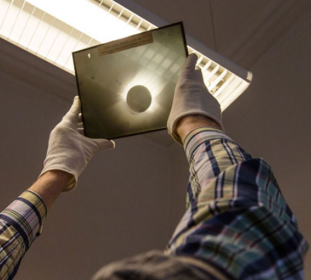
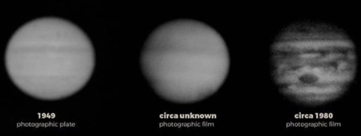
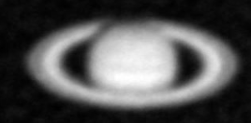
Perkembangan instrumen astronomi:
Era Fotografi (1840-an)
Cassini 1666
Observatorium Bosscha
1949
1980
Astronom dapat merekam gambar lebih baik dan dapat mengumpulkan foton lebih lama
2 Feb 1975

Slide 17
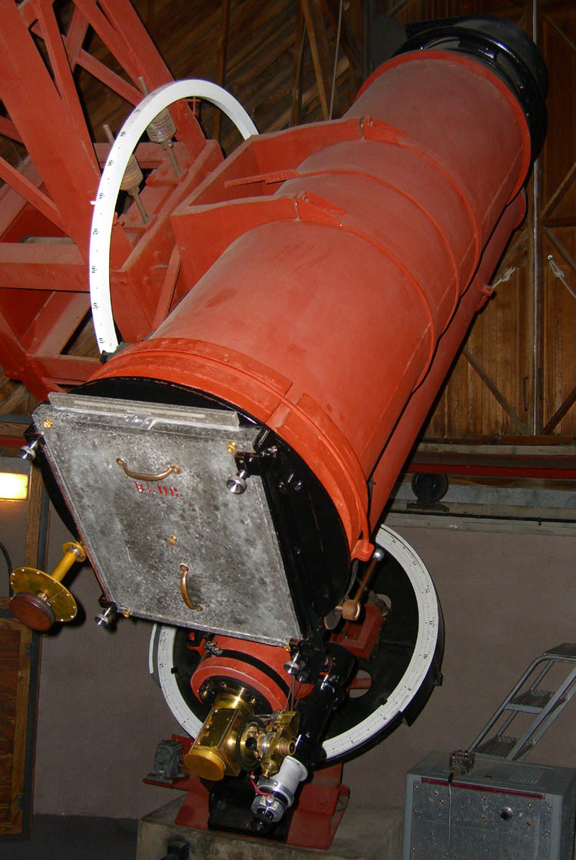
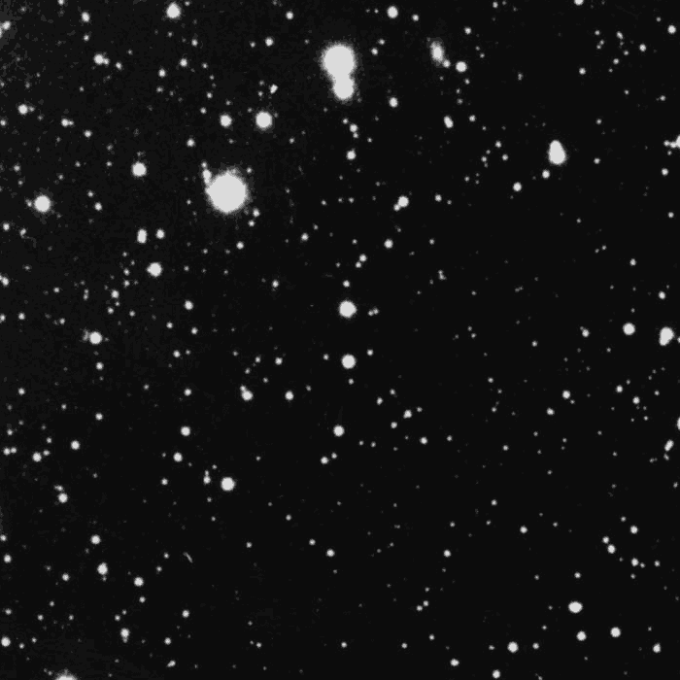
Penemuan [planet]: Pluto (1930)
Teleskop yang digunakan Clyde Tombaugh
Pengamatan Pluto, Lowell Observatory, 1930
Notes:
Sejak pertengahan abad ke 19, astronom mulai menggunakan fotografi (tidak lagi menggambar sketsa)

Slide 18
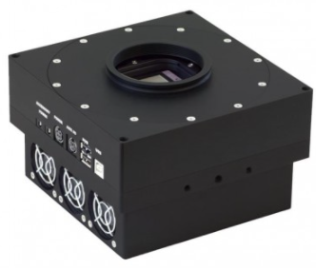
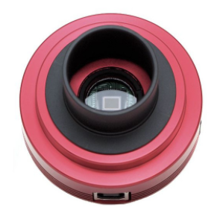
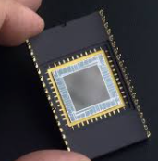
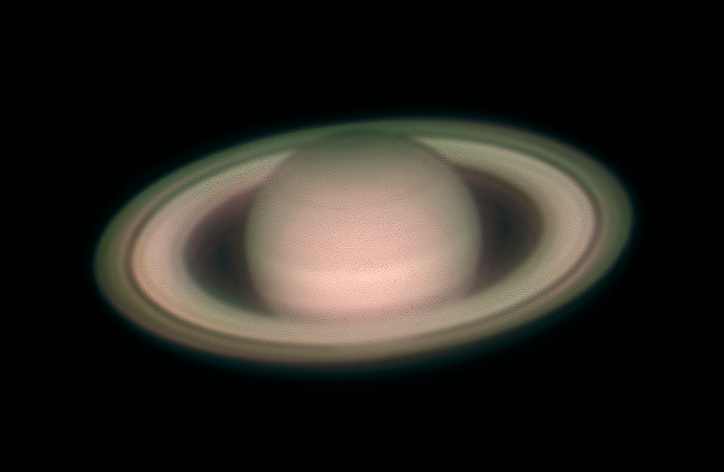
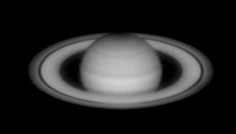
Era Fotografi Digital (1960-an)
1966
1975
2016
2019
Kamera digital lebih sensitif, dapat dioperasikan jarak jauh (wahana), dan data dapat diolah lebih lanjut.

Slide 19
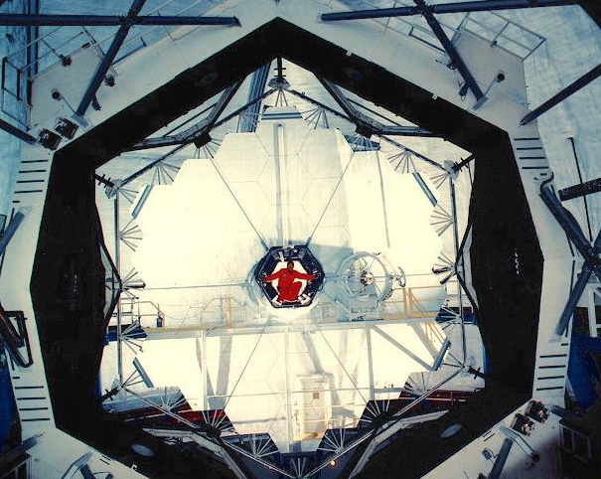
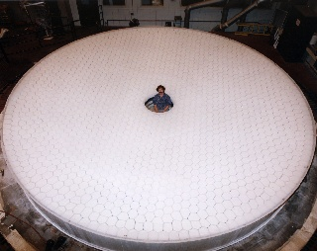
Pembangunan teleskop besar
Teleskop Keck 10 m (1996)
Teleskop LBT 8,4 m (2005)

Slide 20


Pengamatan tumbukan komet Shoemaker-Levy (Juli 1994)
HST/NASA/ESA
Notes:
Sejak pertengahan abad ke 19, astronom mulai menggunakan fotografi (tidak lagi menggambar sketsa)

Slide 21


Penemuan planet kerdil
https://youtu.be/b9oou3p1e3w (NASA Spitzer)
IAU GA 2006
Definisi planet:
mengorbit matahari
memiliki massa cukup (nyaris bulat)
lingkungan orbit bersih
Carraro dkk., 2006
Notes:
FoV gambar 3,5’

Slide 22

Keterbatasan pengamatan visual (1)
Objek memancarkan cahaya tidak hanya di visual
Efek atmosfer: Jendela pengamatan visual & radio

Slide 23




Pengamatan astronomi radio (sejak 1937)
HST, Feb 1995
ALMA
NRAO
Australia Telescope Compact Array, Juli 1995
Prinsip pengamatan radio & contoh data pengamatannya

Slide 24



Keterbatasan pengamatan astronomi visual (2)
Gangguan atmosfer: turbulensi udara/seeing
Astronom perlu mengirimkan teleskop dan wahana ke luar angkasa

Slide 25



Perkembangan pengetahuan astronomi: Venus
Galileo 1610
Magellan, 1990-1994
Mariner 10, 1974
Venus secara visual
Venus dengan radar

Slide 26



MRO
Perkembangan pengetahuan astronomi: Mars
Huygens 1672
De la Rue 1856
Badai debu di Mars (Damien Peach/Anthony Wesley)
VLA radar: geologi Mars
Notes:
This is a radar image of Mars, made with the NASA Goldstone-Very Large Array (VLA) radar system in 1988. Red areas are areas of high radar reflectivity. The south polar ice cap, at the bottom of the image, is the area of highest reflectivity. The other areas of high reflectivity are associated with the giant shield volcanoes of the Tharsis ridge. The dark area to the West of the Tharsis ridge showed no detectable radar echoes. The investigators call this region the “Stealth” region and believe it is a huge deposit of low density, volcanic ash with an absence of volume scatterers (rocks) to depths of many meters.

Slide 27


Perkembangan pengetahuan astronomi: Jupiter (1)
SAAO, Stobie & Whitelock, 1996
Voyager 1
Notes:
Rotasi Jupiter

Slide 28



Perkembangan pengetahuan astronomi: Jupiter (2)
Kutub selatan Jupiter dari Juno (NASA)
Aurora di Jupiter (NASA)
Pemanasan di kutub Jupiter (Subaru, 2017)

Slide 29





Perkembangan pengetahuan astronomi: Saturnus
2013 2017
Kutub utara Saturnus
Cincin Saturnus dari Cassini (NASA)
Pembentukan satelit baru?
Notes:
Cassini instruments provide complementary information about the structure of Saturn's rings. Narrow and wide angle cameras provide images in the visible region of the electromagnetic spectrum much like a digital camera does. The images have information about how the ring structure differs both with distance from the planet and with position around the equatorial circle. However, resolution is usually limited to few kilometers at best. Radio and stellar occultations of the rings also provide important information about ring structure, but only along a one-dimensional track through the rings. The radial resolution can be as fine as 50 meters (164 feet). An "image" is then constructed by assuming circular symmetry over the ring region of interest. Color is usually added to encode other information related to the observed structure. This image compares structure of Saturn's rings observed by these two approaches. The upper half is a natural color mosaic of images of the illuminated side of the rings by the Cassini narrow-angle camera (see PIA06175). The bottom simulated image is constructed from a radio occultation observation conducted on May 3, 2005. For another view created using this process, see PIA07872. Color in the lower image is used to represent information about ring particle sizes. Three simultaneous radio signals of 0.94, 3.6, and 13 centimeter wavelength (Ka-, X-, and S-bands) were sent from Cassini through the rings to Earth. The observed change of each signal as Cassini moved behind the rings provided a profile of the distribution of ring material as a function of distance from Saturn, or an optical depth profile. This simulated image was constructed from the measured optical depth profiles. Shades of purple, primarily over most of the middle ring, the B ring, and the inner portion of the outer ring, the A ring, indicate regions where there is a lack of particles less than 5 centimeters (about 2 inches) in diameter. Green and blue shades indicate regions where there are particles of sizes smaller than 5 centimeters (2 inches) and 1 centimeter (less than one third of an inch), respectively, primarily in the outer A ring and within most of the inner ring, the C ring. The saturated broad white band near the middle of the B ring is the densest region of the rings, over which two of the three radio signals were blocked at 10-kilometer (6-mile) resolution, preventing accurate color representation. From other evidence in the radio observations, all ring regions appear to be populated by a broad range particle size distribution that extends to boulder sizes (several to many meters across).
===================
Commotion at Ring's Edge May Be Effect of Small Icy Object http://www.jpl.nasa.gov/spaceimages/details.php?id=PIA18078 http://www.jpl.nasa.gov/news/news.php?release=2014-112 The disturbance visible at the outer edge of Saturn's A ring in this image from NASA's Cassini spacecraft could be caused by an object replaying the birth process of icy moons. The image is adapted from one in a paper in the journal Icarus, reporting the likely presence of an icy body causing gravitational effects on nearby ring particles, producing the bright feature visible at the ring's edge. The object, informally called "Peggy," is estimated to be no more than about half a mile, or one kilometer, in diameter. It may be in the process of migrating out of the ring, a process that one recent theory proposes as a step in the births of Saturn's several icy moons. This image is a portion of an observation recorded by the narrow-angle camera of Cassini's imaging science subsystem on April 15, 2013. The bright feature at the edge of the A ring is about 750 miles (about 1,200 kilometers) long. This view looks toward the illuminated side of the rings from about 53 degrees above the plane of the rings. It was obtained from a distance of approximately 775,000 miles (1.2 million kilometers) from Saturn, with a sun-Saturn-spacecraft, or phase, angle of 31 degrees. The scale is about 4 miles (about 7 kilometers) per pixel.
Saturn's north polar hexagon basks in the Sun's light now that spring has come to the northern hemisphere. Many smaller storms dot the north polar region and Saturn's signature rings, which appear to disappear on account of Saturn's shadow, put in an appearance in the background. The image was taken with the Cassini spacecraft's wide-angle camera on Nov. 27, 2012 using a spectral filter sensitive to wavelengths of near-infrared light centered at 750 nanometers. The view was acquired at a distance of approximately 403,000 miles (649,000 kilometers) from Saturn and at a Sun-Saturn-spacecraft, or phase, angle of 21 degrees. Image scale is 22 miles (35 kilometers) per pixel

Slide 31


Apakah pengetahuan kita seputar planet sudah lengkap?
Bagaimana cincin saturnus terbentuk?

Slide 32


Apakah pengetahuan kita seputar planet sudah lengkap?
Mengapa sumbu rotasi Uranus sangat miring?
HST (NASA/ESA)

Slide 33



Apakah pengetahuan kita seputar planet sudah lengkap?
Adakah planet 9 atau bahkan planet X?
scaled Runge–Lenz vectors
TG387 (Subaru)
Batygin & Brown, 2016

